Slide 1
Azure Fundamentals Partner Practice Enablement
WLAN Code (event):
msevent700di
Clemens Siebler
Cloud Solutions Architect
clemens.siebler@microsoft.com
Jose Moreno
Cloud Solutions Architect
jose.moreno@microsoft.com

Slide 2

Logistics
Beginn um 09:30 Uhr
Begrüßungskaffee ab 09:00 Uhr
1.Kaffeepause 10:45-11:00Uhr
Mittag 13:00-13:45 Uhr
2.Kaffeepause 15:00-15:15 Uhr
Ende gegen 17:00 Uhr
Feedback:
WLAN:
SSID: MSFTGuest
Event Attendee Code: msevent700di
Housekeeping
Catering (Passwort für die Kantine “Azure”)
Restrooms
Mitarbeiten willkommen!
Feedback

Slide 3
Feedback
https://aka.ms/azurefun-umfrage

Slide 4
Feedback
https://aka.ms/azurefun-umfrage

Slide 5
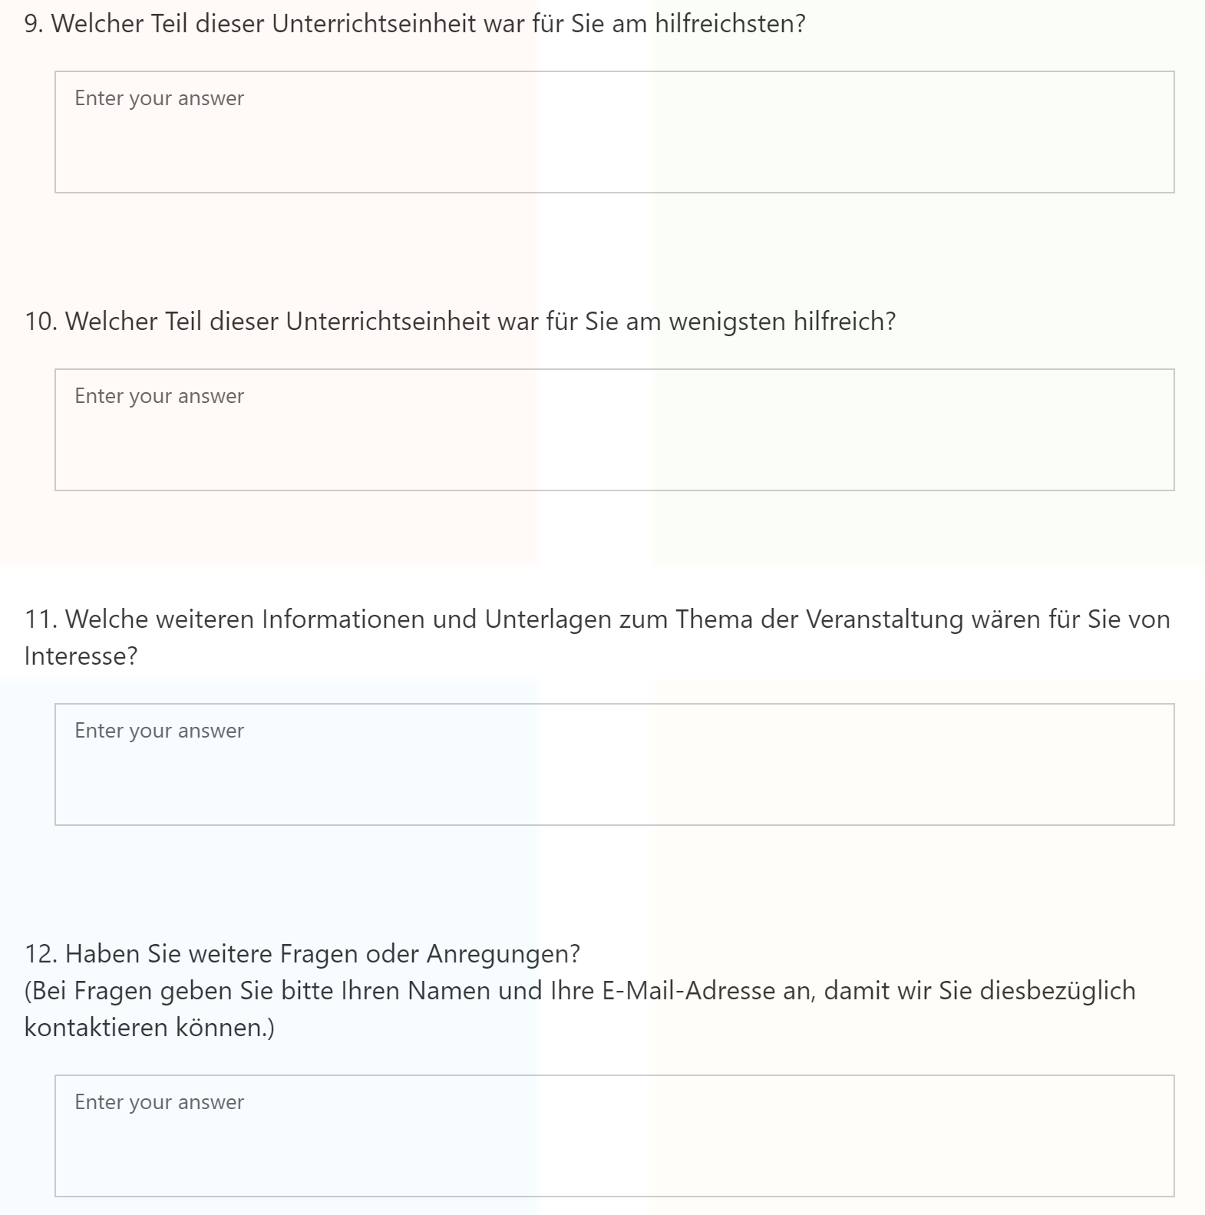
Umfrage
Vielen Dank im Voraus!!

Slide 6
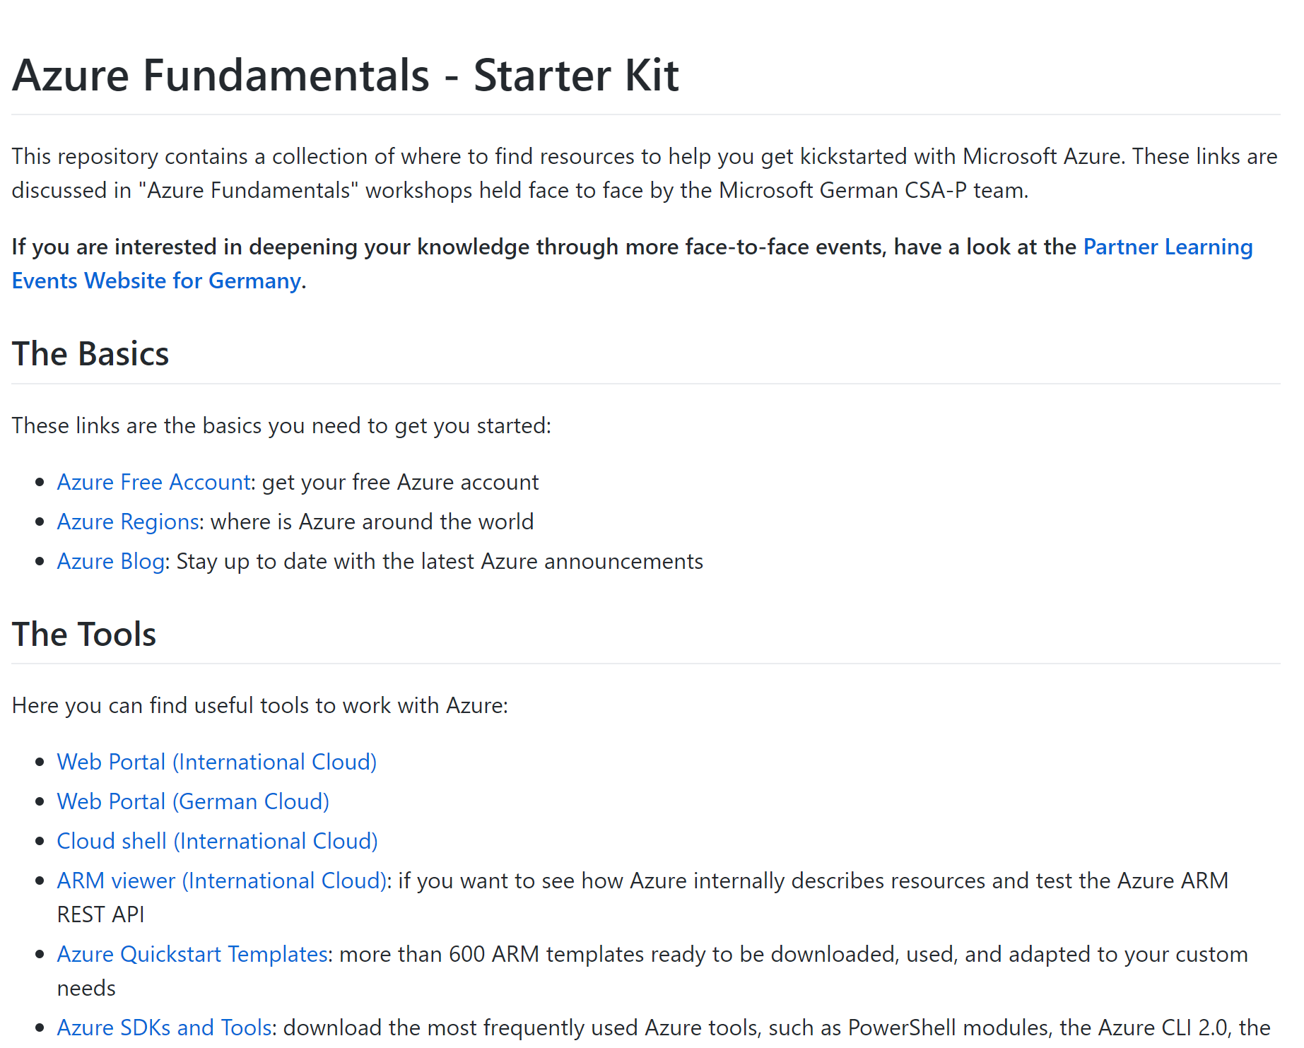
Link collection
https://aka.ms/azurequickstart

Slide 7
Agenda
Intro
Azure Management
Authentication
IaaS: Compute, Storage, Network
Web Apps
Databases
Linux Containers

Slide 8
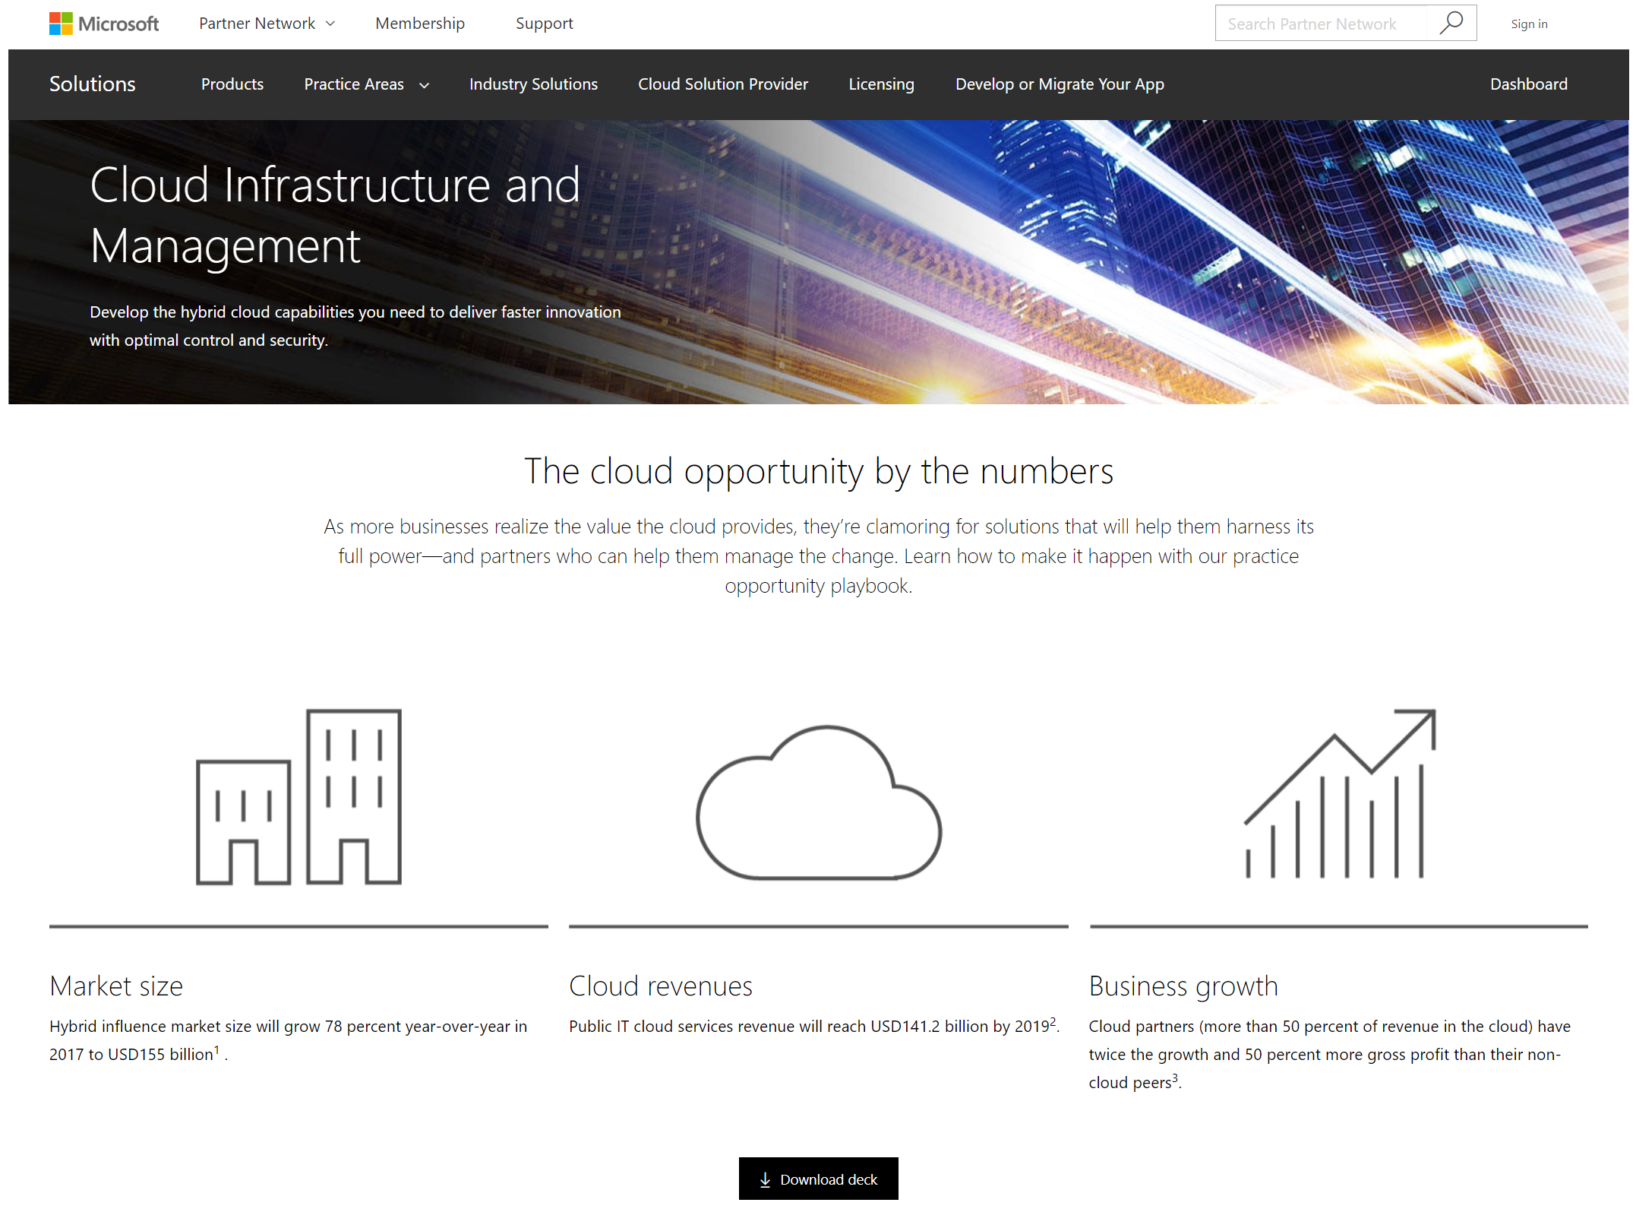
Find more information in
https://www.microsoftpartnerserverandcloud.com

Slide 9

Cloud adoption rising
$72B
IaaS cloud services market by 2020
91%
ITDMs believe hybrid cloud is long term

Slide 10
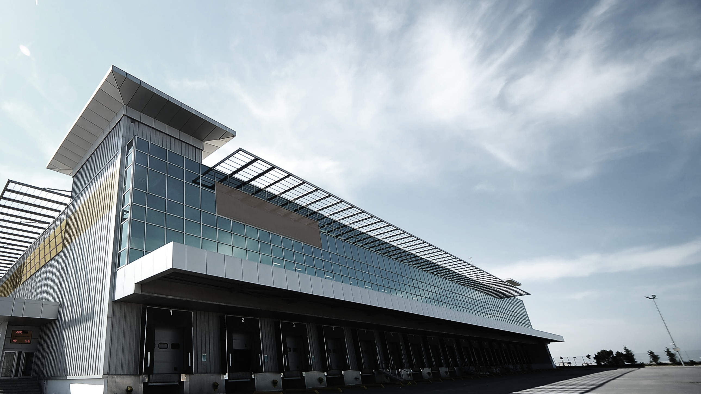
Customers want out of the datacenter
80%
global IT budgets
spent on maintenance
28%
time spent on administrative tasks

Slide 11
What trends are driving complexity?
New apps
Device proliferation
Cyber threat detection
Data explosion
Cloud computing
Notes:
There are five important questions customers claim are keeping them up at night:
How do I deliver next-generation applications? As the interest in cloud computing and providing web-based IT services grows, our customers tell us that they need a scalable web platform and the ability to build, deploy, and support cloud applications that can run on-premises or in the cloud. They also want to be able to use a broad range of tools and frameworks for their next-generation applications, including open source tools.
How do I support modern work styles? As the lines between people’s lives and their work blur, their personalities and individual work styles have an increasing impact on how they get their work done—and which technologies they prefer to use. As a result, people increasingly want a say in what technologies they use to complete work. This trend is called “Consumerization” of IT. As an example of “consumerization,” more and more people are bringing and using their own PCs, slates, and phones to work. “Consumerization” is great as it unleashes people’s productivity, passion, innovation, and competitive advantage. We at Microsoft believe that there is power in saying “yes” to people and their technology requests in a responsible way. Our goal at Microsoft is to partner with you in IT, to help you embrace these trends while ensuring that the environment is more secure and better managed.
How do I help protect my business from cyber threats?
Increasingly, your business is more and more at risk from modern attackers using enhanced techniques to exploit paradigm shifts in technology, as people embrace trends in mobility and the cloud—attacks are becoming more sophisticated, using legitimate user credentials and professional IT tools to infiltrate your network and take control of your infrastructure. Unfortunately, traditional IT security tools can only provide limited protection in the new and emerging scenarios. How do I increase the efficiency in my datacenter? The business of information management—helping organizations to make sense of their proliferating data—is growing by leaps and bounds. In recent years Oracle, IBM, Microsoft and SAP between them have spent more than $15 billion on buying software firms specializing in data management and analytics. Whether you are building your own private cloud, are in the business of offering cloud services, or simply want to improve the operations of your traditional datacenter, lowering infrastructure costs and operating expenses while increasing overall availability of your production systems is critical. Microsoft understands that efficiency built into your server platform and good management of your cloud and datacenter infrastructure are important to achieving operational excellence.
How do I embrace the cloud? With a hybrid cloud, you get to use the Azure public cloud as an extension of your datacenter – maintaining control and connectivity to your on-premises private cloud, while taking advantage of the cost efficiencies and hyper-scale of the public cloud. The cloud doesn’t have to mean abandoning your on-premises IT investments. A hybrid cloud can help you cost-effectively expand storage for growing data needs, provide effective off-site backup for your data center or even aid with disaster recovery. The low up-front costs and capabilities of a hyper-scale cloud provider enable anyone to differentiate through new and innovative products and services.

Slide 12
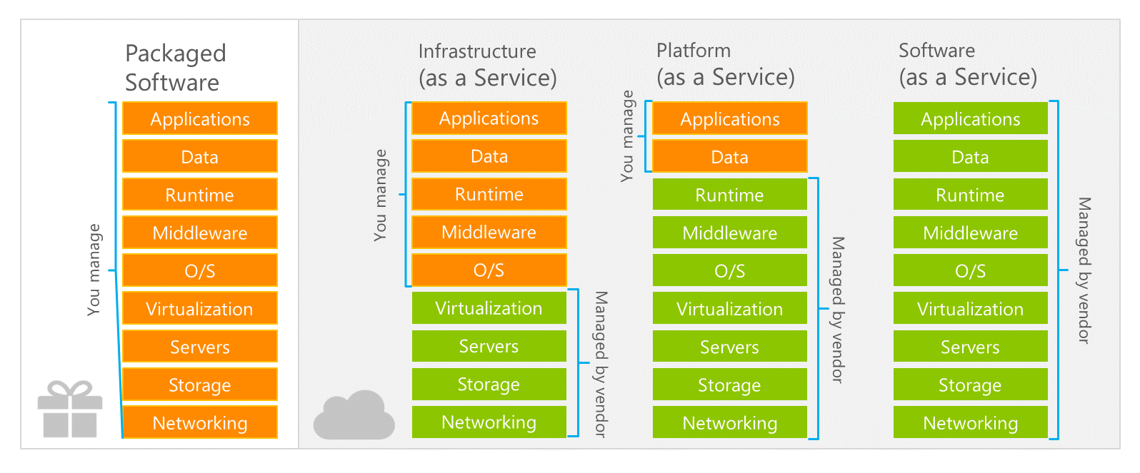
IaaS vs PaaS vs SaaS: offloading complexity
Do It Yourself
Notes:
Slide Objectives
Explain the differences and relationship between IaaS, PaaS, and SaaS in more detail
Speaker Notes
Another way to look at the cloud services taxonomy and how this taxonomy maps to the components in an IT infrastructure is as follows:
Packaged software: With packaged software, a customer would be responsible for managing the entire stack, ranging from the network connectivity to the applications
IaaS:
With IaaS, the lower levels of the stack are managed by a vendor. Some of these components can be provided by traditional hosters. In fact, most of them have moved to a virtualized offering
Very few actually provide an OS
The customer is still responsible for managing the OS through the applications
An obvious benefit with IaaS is that it frees the developer from many concerns when provisioning physical or Virtual Machines (VMs)
This was one of the earliest and primary use cases for Amazon Web Services Elastic Cloud Compute (EC2)
Developers were able to readily provision VMs (Amazon Machine Images, abbreviated as AMIs) on EC2, develop and test solutions and, often, run the results in production
The only requirement was a credit card to pay for the services
PaaS:
With PaaS, everything from the network connectivity through the runtime is provided and managed by the platform vendor
Microsoft Azure fits best in this category today
In fact, because we do not provide access to the underlying virtualization or OS today, we are often referred to as not providing IaaS
PaaS offerings further reduce the developer burden by additionally supporting the platform runtime and related application services
With PaaS, the developer can immediately begin creating the business logic for an application
Potentially, the increase in productivity is considerable. In addition, since the hardware and operational aspects of the cloud platform are also managed by the cloud platform provider, applications can quickly be taken from an idea to reality
SaaS:
Finally, with SaaS, a vendor provides the application and abstracts you from all of the underlying components
[EDITOR] Biju
04 October 2013 Kindly provide substantiation for the claim made against third-party software.

Slide 13
When to start with cloud? Business Triggers
Software end of support
Contracts, licenses up for renewal
Datacenter consolidation
Without software updates, your business can become vulnerable to cybersecurity threats, might not meet regulatory requirements, and might be out of compliance.
Rather than just renewing current outsourcing contracts or on-premises licenses, consider how you can leap forward through modernization.
Reduce or eliminate expensive datacenters, lower costs, and explore new possibilities with modernization.
Protect critical business assets
Business need for new capabilities
With the rise of modern threats, it is critical today to apply the right level of security on your critical assets and on the underlying infrastructure they are using.
Out of capacity or contending with Shadow IT? Remain relevant to business units by delivering new cloud capabilities and value with speed and agility.
Notes:
Note: There are “double click” slides for each of these (aside from “Protect Critical Business Assets”) in the appendix. Please use them at your discretion.
Slide Goal: Get customers to consider other reasons to modernize. Highlight that we can help them overcome challenges beyond end of support.
Talk Track: While software end of support is major event that could lead to the need for modernization, there are other events that could compel a modernization effort. There are several business and technology events that can trigger the opportunity to modernize. All of these are somewhat predictable and can be foreseen in the future. For example, you know when your existing license agreements are expiring. All of these are directly related to the cost of IT.

Slide 14

Yes, but why should I go to the cloud?
Build infrastructure in a matter of hours
Tap into services that are unavailable on-premises
Consume near-limitless resources on-demand and only pay for what you need
Modernize to the latest platforms & services
React to business demands faster with more agility than ever before
Focus on innovation rather than facilities
Notes:
Need an example? Ask the customer if they can build a machine learning service in their datacenter? Or how many millions of dollars in equipment and services it would take to do that…or they can simply use the Azure ML service.

Slide 15
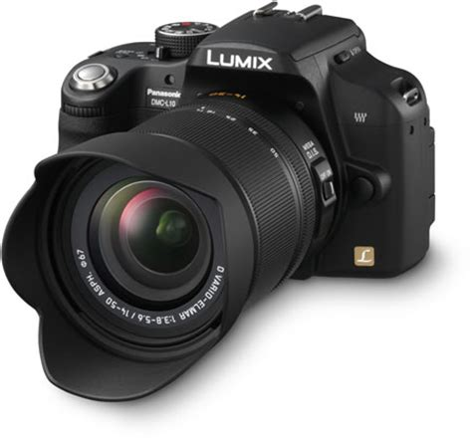
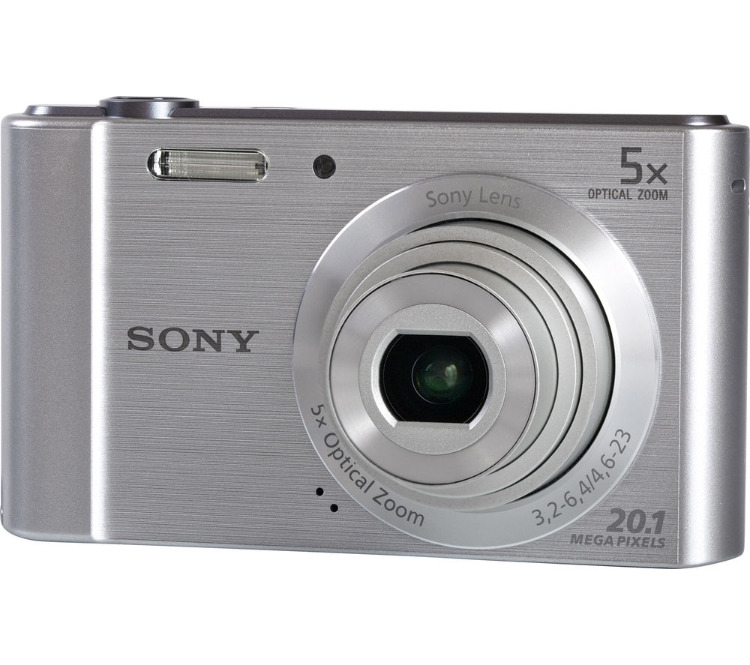

Cloud sales: how would you approach it?
Business Value
(Transformation)
Features
Price

Slide 16
My Advice: lead with transformation
Business units often don’t perceive value in a simple operating system upgrade. Enterprise Modernization addresses the business benefits of transforming applications and/or infrastructure across on-premises and cloud platforms.
Infrastructure
Security and identity
Applications
Operations
Notes:
Leading with transformation: Our approach to modernization goes beyond simply “Lifting and Shifting” your existing assets. We take a focused approach to solving business problems with transformational, organizational-wide technical solutions and processes. We aim to help drive a paradigm shift away from typical upgrade cycles and instead focusing on new capabilities made possible by cloud operating models. We also balance this as it does not necessarily make sense to lead with completely transforming workloads in all instances, hence we assess each Business System and work with the customer to determine the best approach on a case-by-case basis.

Slide 17
Azure Hybrid cloud consistency
Azure Active Directory
Azure Management and Security
Azure
Data Services
Azure Services
Common identity
Management and security
Data platform
Unified development
Active
Directory
On-premises
Infrastructure
SQL Server
Azure Stack

Slide 18
Azure hybrid use benefit
Up to 40 percent savings on Windows Server in Azure
Without Azure hybrid use benefit
Only on Azure!
With Azure hybrid use benefit
$2,964
$1,777
Sample annual cost comparison of two D2v2 Promo VMs

Slide 19
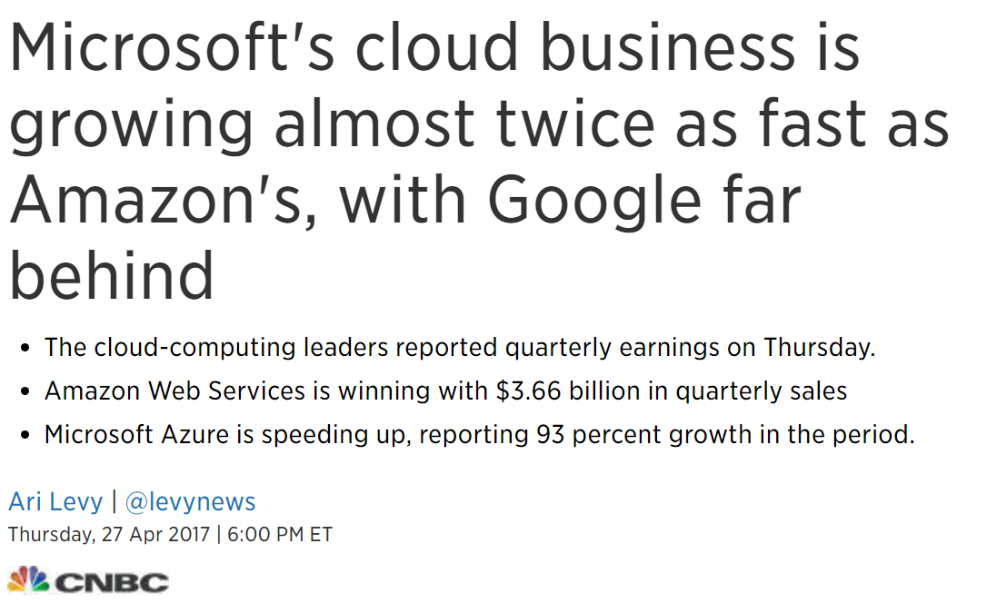
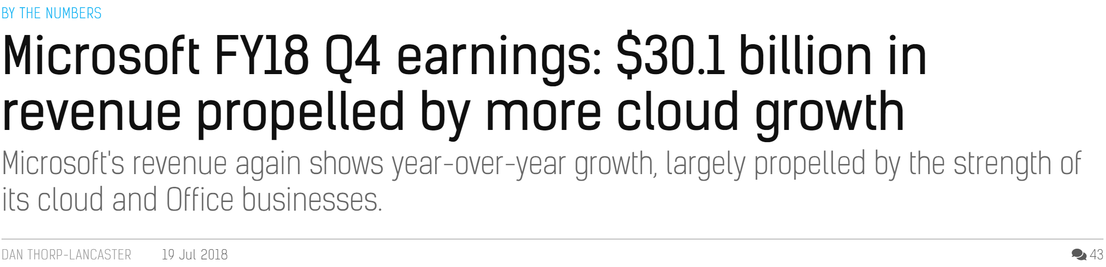
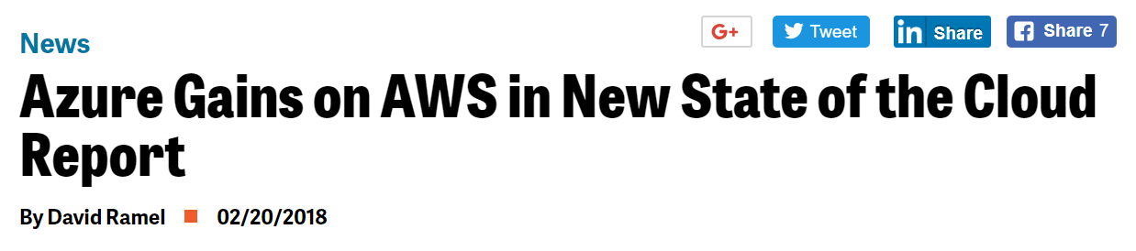
Erstmals.... Danke!
120,000
Neue Azure Abonnements/Monat
20 Mio.
SQL Datenbank Stunden benutzt jeden Tag
>50 Bio.
Speicherobjekte in Azure
“
“
425 Mio.
Azure Active Directory Benutzer
60 Mrd.
Hits in Webseiten auf Azure Web App Service
>90%
Fortune 500 Unternehmen benutzen Microsoft Cloud
Microsoft is growing its cloud revenue faster than Amazon
—Business Insider 2016
>5 Bio.
Speichertransaktionen im Monat
1 Bio.
Nachrichten pro Monat mit Event Hubs
1.4 Mio.
SQL Datenbanken ausgerollt in Azure
1 Bio. = 1,000 Mrd.
Notes:
Objective:
It is important to give some sense of the scale of the cloud, the rapid pace of adoption and how MSFT is doing
Key Points:
The cloud is still quite new and already we are talking about billions and trillions of things –imagine what this will look like 5 years from now
Adoption of Azure is off the chart by any scale – 100,000+ new customers come to Azure every month and this pace is increasing
References:
https://www.businessinsider.com.au/microsoft-azure-vs-aws-revenue-2016-1
https://www.cnbc.com/2017/04/27/microsoft-azure-growing-faster-than-aws-google-cloud-behind.html
https://virtualizationreview.com/articles/2018/02/01/state-of-the-cloud.aspx

Slide 20
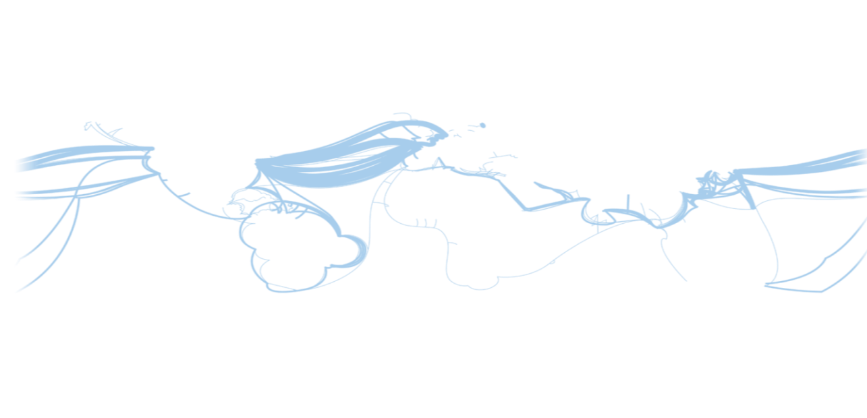
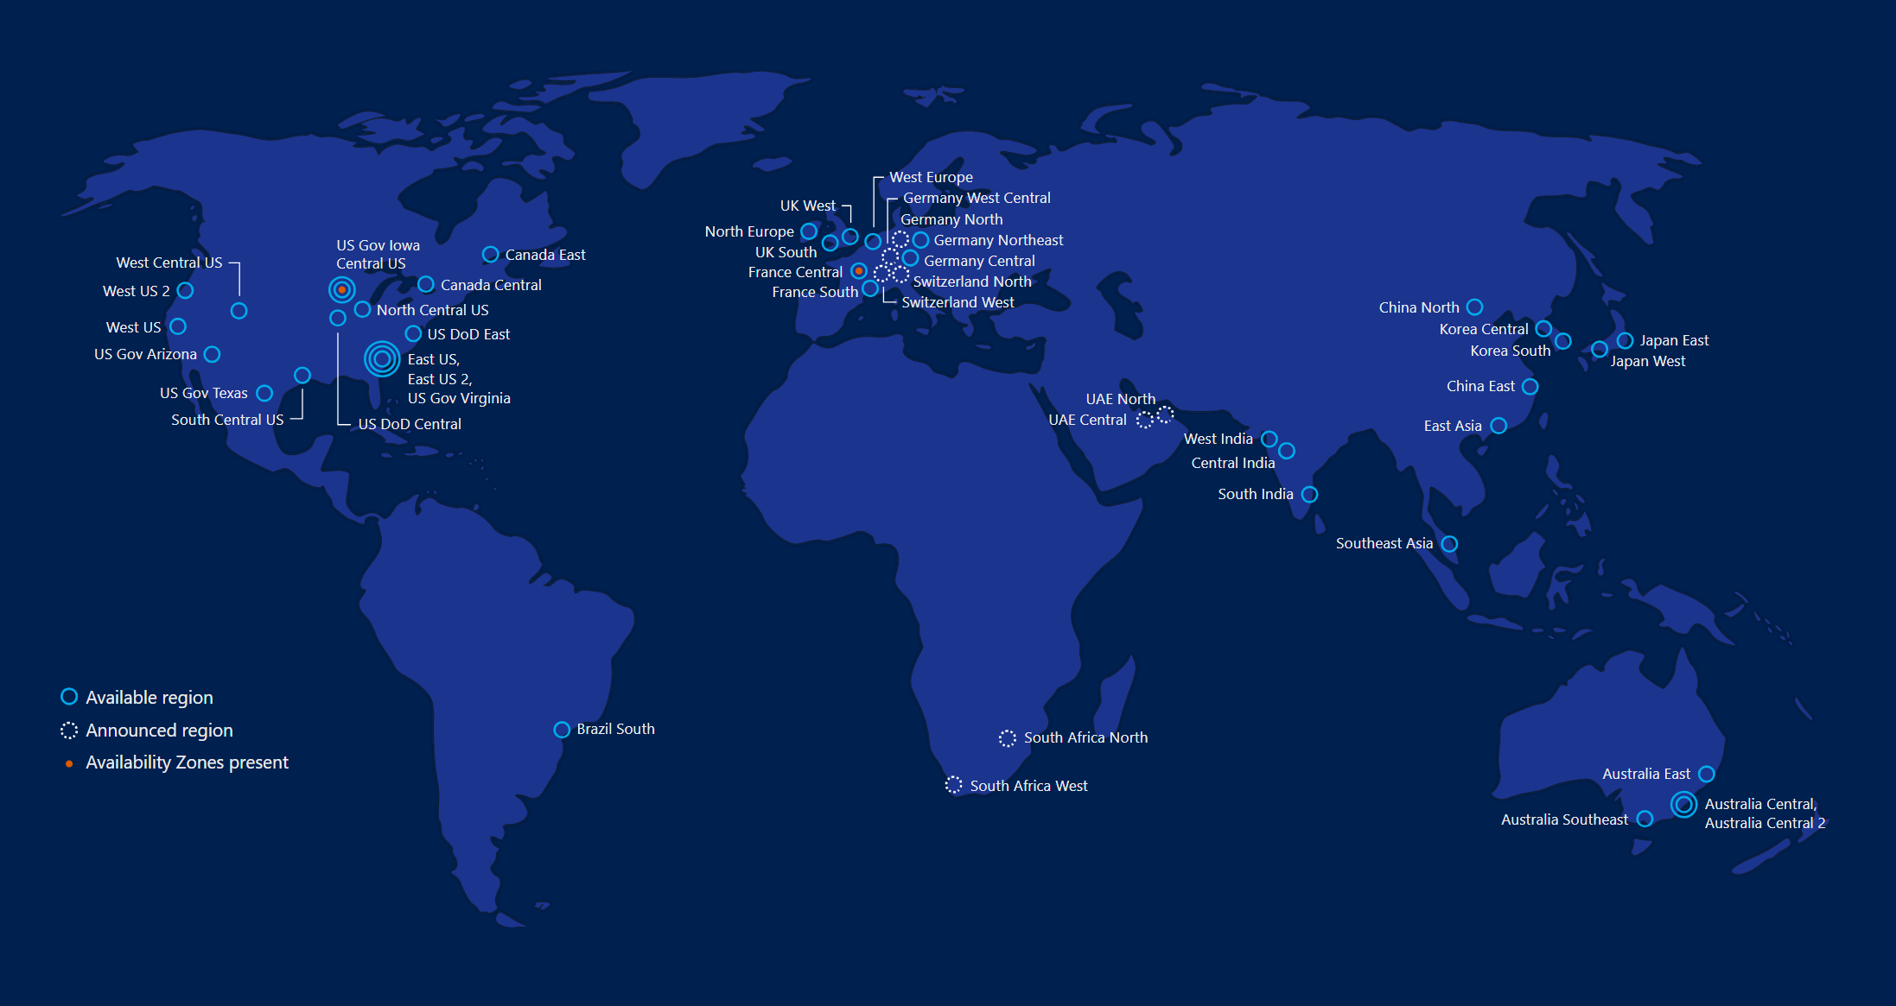
Hyperscale Infrastruktur ermöglicht die Cloud
50 Regionen weltweit Kontinuierliches Wachstum! Modernste Infrastruktur
https://azure.microsoft.com/en-us/regions/
Notes:
Why this Slide:
This is SUCH a big investment – it’s a game for only very few. It’s not new for us – we have been doing this for our own services and our consumer/web properties for 20+ years
Key Points:
Where are we – EVERYWHERE…!
How big is this - $15+ B and counting – this is serious, we continue to bet big and you can count on us
Talk about DC innovation – DC Efficiency and Gen 5 data centers.
Scale – at this scale you do get efficiencies – the main one being POWER
Remember our “strategy” – we will be in the major places, but not everywhere – we have Azure Stack/Hosters for that.
Transition to NEXT Slide: This is the physical infrastructure that Azure sits on, now lets talk about Azure the PLATFORM

Slide 21









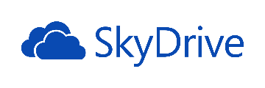

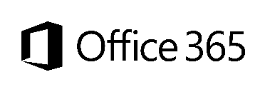

Microsoft Azure – Eine solide Plattform
18.2% Marktanteil in US
Skype Benutzer verbrauchen bis 2 Mrd. Minuten am Tag damit
Über 250 Mio. Benutzer
1.5 Mrd. Halo Spiele
Über 8 Mio. registrierte Benutzer
48 Mio. Benutzer in 41 Länder
Über 3.5 Mio. Bentuzer von Dynamics CRM
11 Mrd. Bilder
Outlook.com hat über 400 Mio. aktive Benutzer und ist der schnellst wachsende Emaildienst weltweit
1 Mrd. mobile Benachrichtigungen im Monat
Fast 50 Mio. Benutzer
Xbox lieferte 740 Mio. Unterhaltungsstunden
Notes:
Key Points: Microsoft’s service platform supports not only partners as a platform provider, but supports Microsoft’s own business. The platform is battle-tested at scale.
In many ways, Microsoft’s cloud starts with first-party services. Between services they’ve built and services they’ve acquired - Microsoft has invested to become the second-largest provider of end-user services on the planet. (Google is first, Microsoft is second.) They service hundreds of millions of people and billions of transactions. What that means is that they’ve learned a LOT about managing services at scale. Over time with a lot of investment, they’ve built datacenters around the world. They’ve scaled up for data privacy and scalability and redundancy – all as mission-critical requirements – to provide these services with reliable uptime around the world, and they’ve learned how to do it.

Slide 22





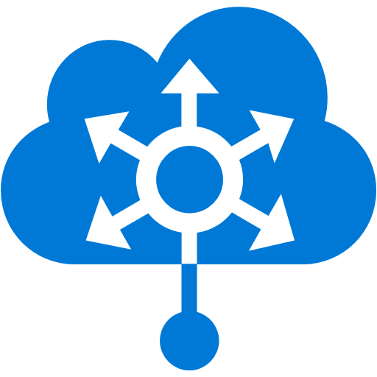

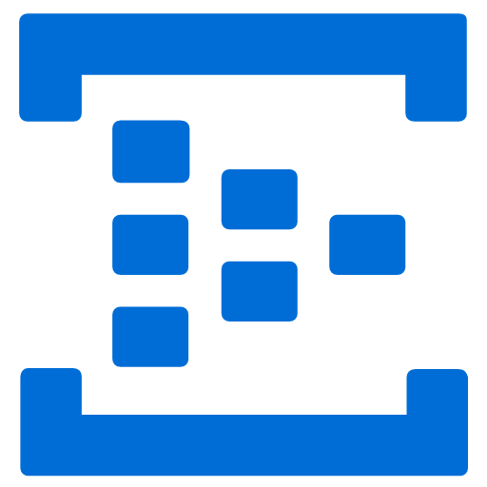



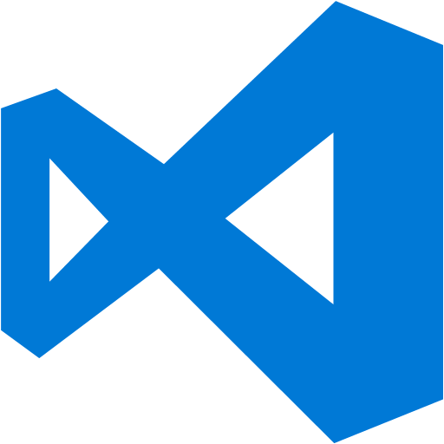












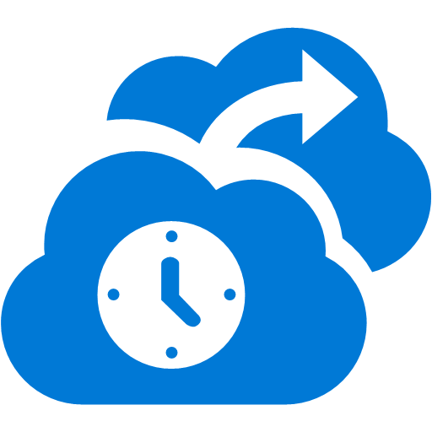



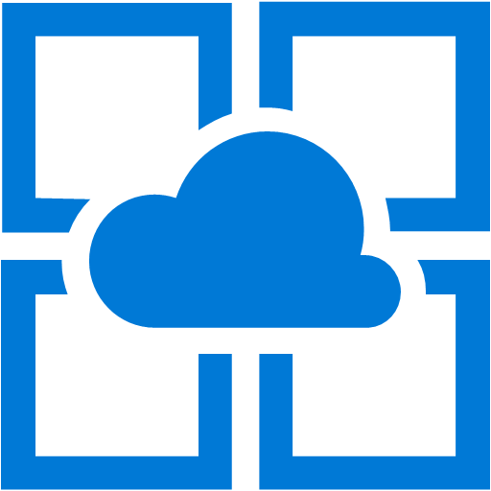




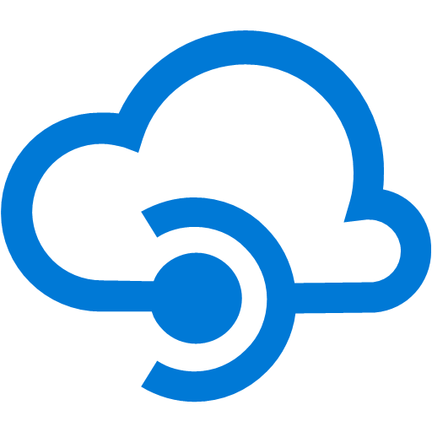


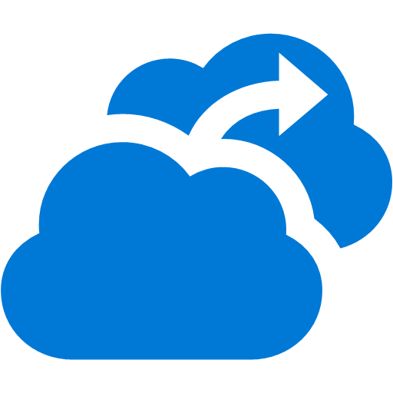
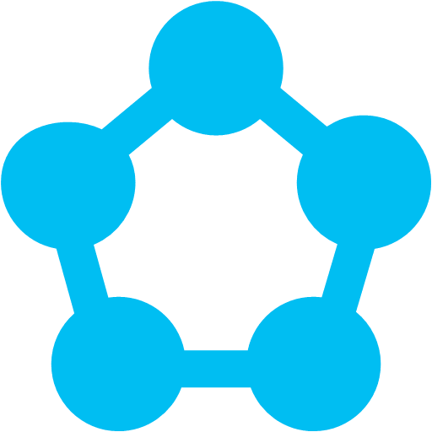







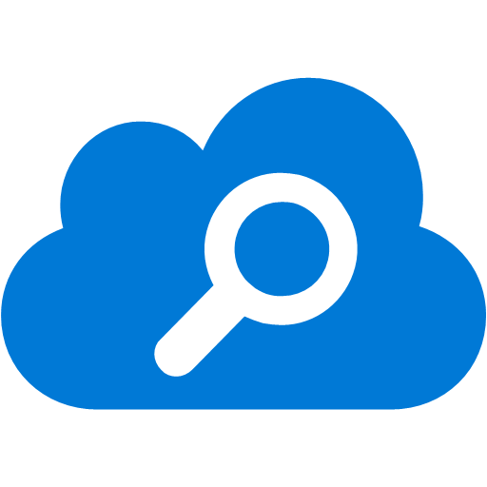
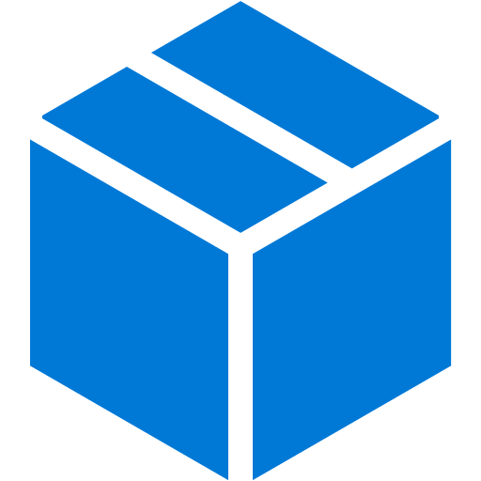
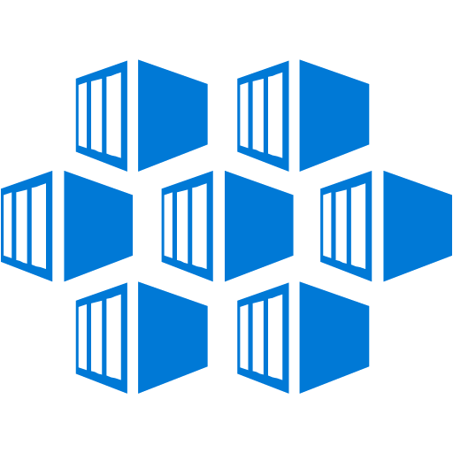






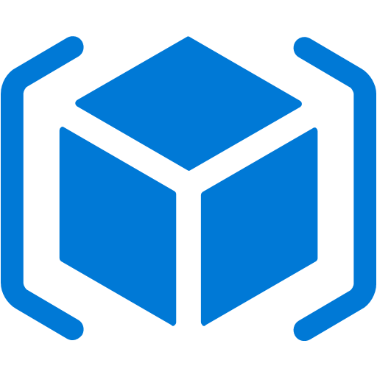



Zahlreiche PaaS und IaaS Dienste
IoT Suite |  |  |  |  |  |  |  |  |  |  |  | Virtual Machines
IoT Hub | Data Lake Analytics | Azure Monitor |  |  |  |  |  | Media Services | DevTest Labs | Azure AD | BizTalk Services | Cloud Services
Event Hub | Data Lake Store | Network Watcher |  |  |  |  |  | CDN | VS Team Services | Azure AD B2C | Service Bus | Batch
Stream Analytics | HDInsight | Virtual Network | ExpressRoute | Traffic Manager | Load Balancer | Azure DNS | VPN Gateway | App Gateway | VS App Insights | Azure AD DC | Backup | Functions
Machine Learning | Data Factory | App Service | Web Apps | Mobile Apps | Logic Apps | API Apps | API Management | Mobile Engagement | HockeyApp | Multi-Factor Auth | Site Recovery | Service Fabric
Notification Hubs | Data Catalog | SQL Database | Cosmos DB | Redis Cache | Storage | StorSimple | Search | SQL DW | SQL Stretch DB | Import/Export | Premium Storage | Linux Containers
Scheduler | Automation | Log Analytics | Key Vault | Security Center | Marketplace | Azure CLI | Templates | DSC | PowerShell | Azure SDK | Rest API | Azure Portal
#_

